Slide 1
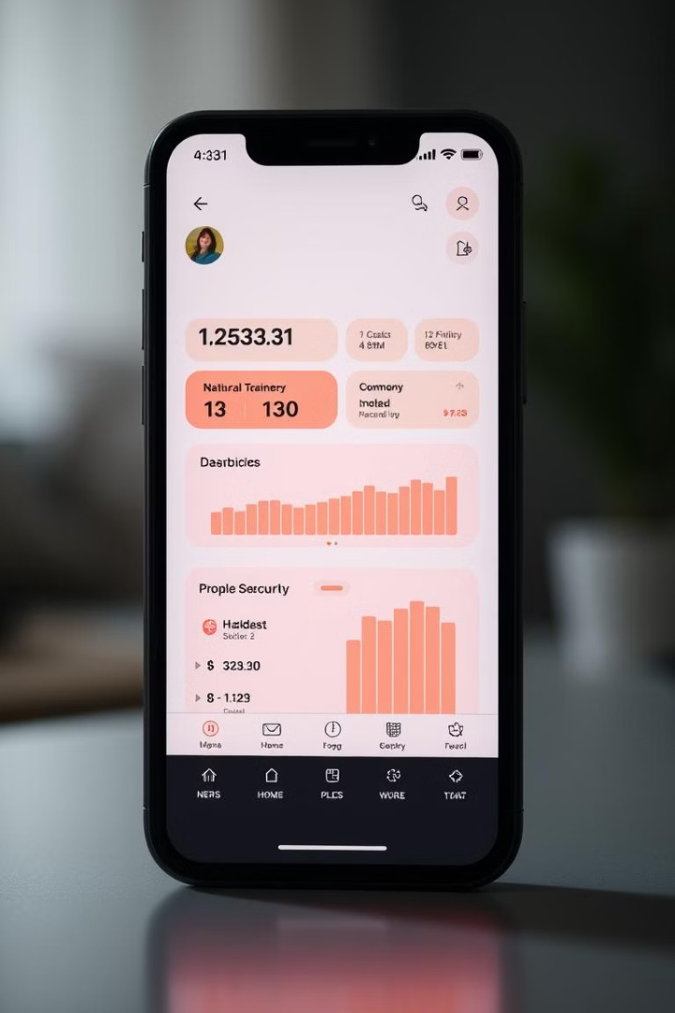
Controlling Smart Security Systems Using Mobile Applications
Smart home security systems are becoming increasingly popular. They provide a convenient and effective way to control security features remotely through mobile apps. This presentation explores how mobile applications empower homeowners to enhance safety and peace of mind.
S.Praneetha(192211498)
M.Manasa(192211489)

Slide 2

The Need for Enhanced Home Safety
1
Rising Crime Rates
2
Vulnerability of Homes
Home burglaries and other crimes are on the rise, increasing the need for effective security measures.
Many homes lack sufficient security, leaving them susceptible to intruders and theft.
3
Peace of Mind
Homeowners seek reassurance and a sense of safety in their living spaces.

Slide 3

Integrating Smart Security Devices
Smart Door Locks
Security Cameras
Allow remote locking and unlocking, providing flexibility and control over access.
Provide real-time monitoring, allowing homeowners to view their property remotely.
Motion Sensors
Detect movement and trigger alerts, deterring potential intruders.

Slide 4
Smartphone-Enabled Security Features
Remote Access
Real-time Monitoring
Customized Settings
Control security devices from any location with an internet connection.
View live camera feeds, receive notifications, and monitor activity in real-time.
Personalize security settings, such as scheduling automation and setting sensitivity levels.

Slide 5




Monitoring and Controlling from Anywhere
Travel and Vacation
Stay connected to your home security while traveling or on vacation.
Business Trips
Monitor your home and receive alerts even when you're away for work.
Remote Access
Control security features and respond to events regardless of location.

Slide 6
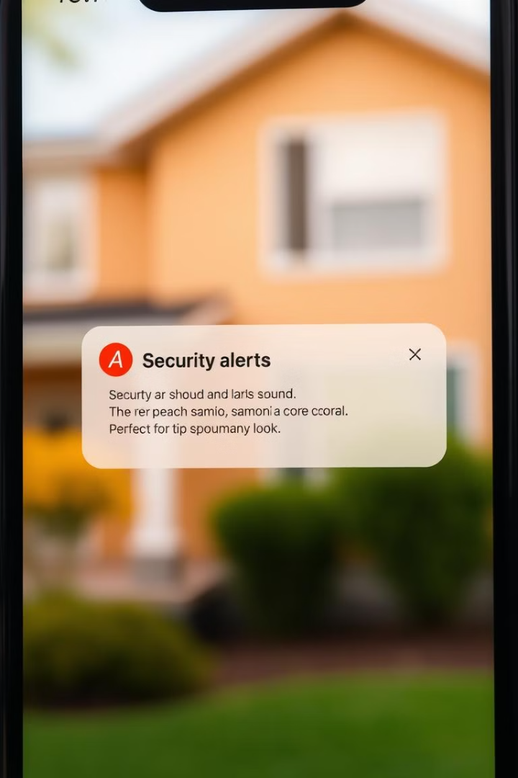



Automated Alerts and Notifications
Motion Detection
Receive instant alerts when movement is detected in designated areas.
Door and Window Openings
Get notifications when doors or windows are opened or closed.
Security System Activation
Receive alerts when the security system is activated or deactivated.

Slide 7
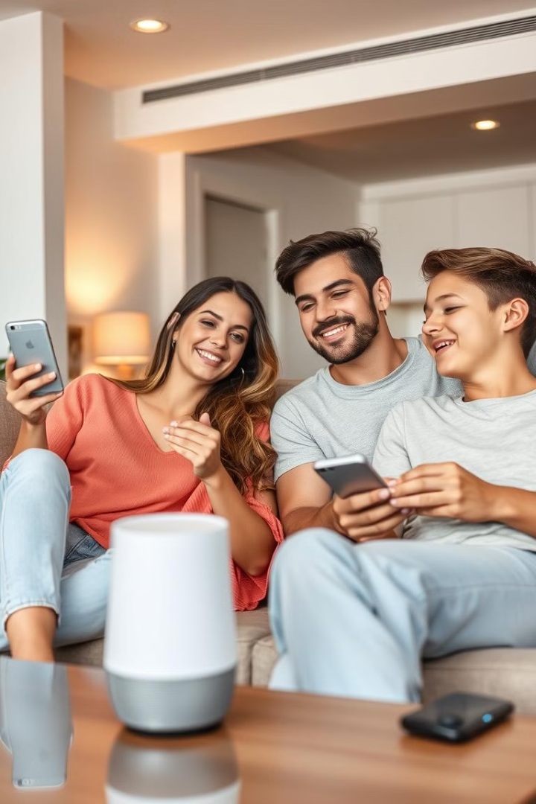
Enhancing User Convenience and Peace of Mind
1
Remote Control
Control security features from anywhere with a few taps on a smartphone.
2
Simplified Management
Manage multiple security devices from a single app interface.
3
Enhanced Security
Increased security measures provide a sense of protection and peace of mind.

Slide 8
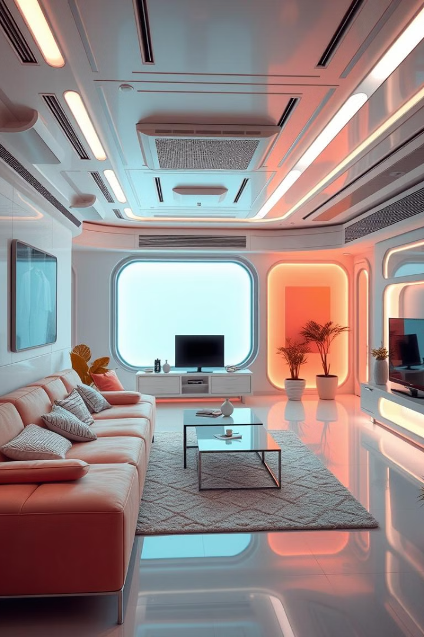
Conclusion: The Future of Smart Home Security
Mobile applications are transforming the way we manage home security. They offer convenience, control, and peace of mind, making smart home security systems an essential part of modern living. As technology advances, we can expect even more innovative features and functionalities to emerge, further enhancing safety and security for homes around the world.

